Slide 1
DR.SNS RAJALAKSHMI COLLEGE OF ARTS AND SCIENCE (Autonomous), Coimbatore Accredited by NAAC A⁺ Grade (III Cycle)
Department of Commerce with Information Technology
COURSE NAME : 17BCI509 - Networking
III Year / V Semester
Unit II : Physical Layer
Topic : Transmission Media – Guided Media

Slide 2
https://tinyurl.com/networkingphysicallayer

Slide 3
PHYSICAL LAYER
It deals with the mechanical and electrical specifications (Devices)
Physical characteristics of interfaces and medium.
To move data in the form of electromagnetic signals across a transmission medium
The physical layer data consists of a stream of bits (sequence of Os or 1s)
Bits are encoded into signals
3

Slide 4
PHYSICAL LAYER
4

Slide 5
Signals
A signal is an electric current or electromagnetic field used to convey data from one place to another.
A Transmitter encodes a message into a signal, which is carried to a receiver by the communications channel.
Signals can be interpreted as either Analog or Digital.

Slide 6
Digital Signals
Digital signals are non-continuous, discrete

Slide 7
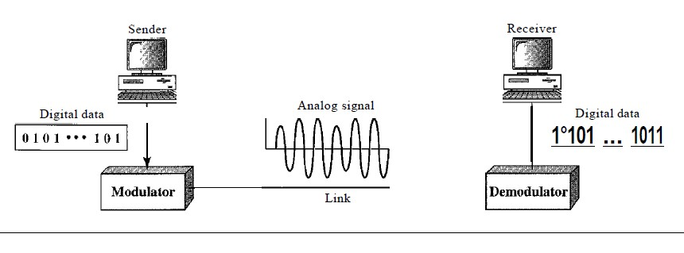
Analog Signals
Analog signals are continuous, non-discrete

Slide 8
Devices
Some of the common devices are:
Hub
Switch
Repeater
Bridge
Modem
PC, Mobile phone, Telephone or Cables etc are also devices use for data communication.

Slide 9
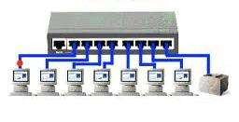
Hub
Centralize device that connects many devices to share data
Less secure

Slide 10
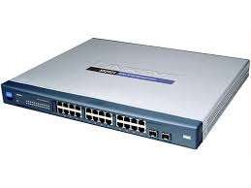
Switch
Device that connects many other devices together to make a network
More intelligent then Hub
More secure

Slide 11
Repeater
Regenerates the signal (Electrical, Wireless or Optical) which are corrupted due to long distance
Overcome the distance limitations of the transmission media.

Slide 12
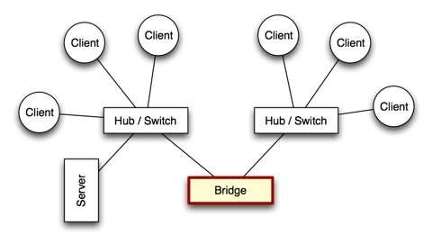
Bridge
Creates a single aggregate network from multiple communication networks

Slide 13
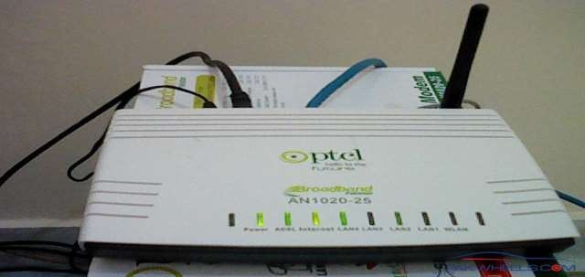
Modem
The word Modem comes from Modulator- Demodulator
Modulation: Digital signals to analog
Demodulation: Analog signals back to Digital

Slide 14
Physical Topologies
How the devices are connected to make a network?
Mesh topology
Star topology
Bus topology
Ring topology
Hybrid topology

Slide 15
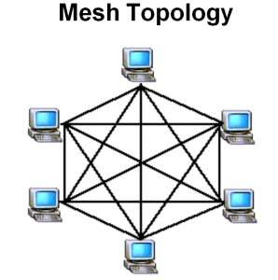
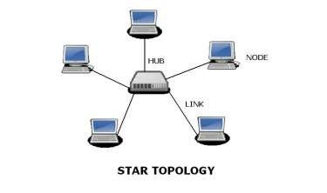
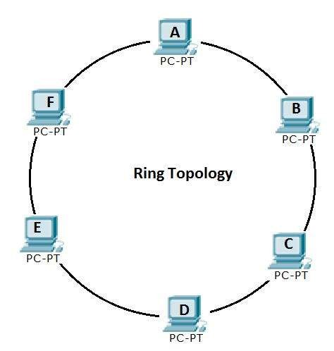
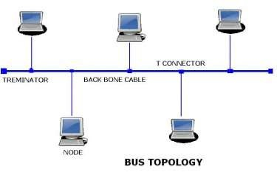

Slide 16
Transmission Medium
Anything that can carry information from a source to a destination.
Uses cables or electromagnetic signals to transmit data.
Types of Transmission Media
1. Wired or Guided Media or Bound Transmission Media
2. Wireless or Unguided Media or Unbound Transmission Media

Slide 17
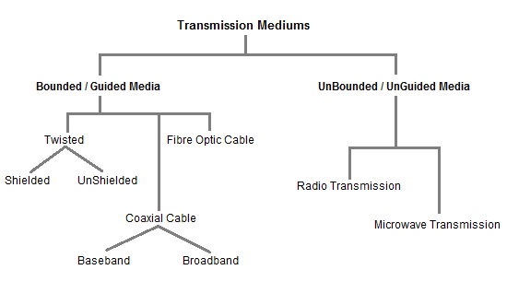

Slide 18
Transmission Media
Transmission medium:: the physical path between transmitter and receiver.
Repeaters or amplifiers may be used to extend the length of the medium.
Communication of electromagnetic waves is guided or unguided.
Guided media :: waves are guided along a physical path (e.g, twisted pair, coaxial cable and optical fiber).
Unguided media:: means for transmitting but not guiding electromagnetic waves (e.g., the atmosphere and outer space).

Slide 19
Transmission Media
Guided Media:
Twisted Pair
UTP
STP
Co-Axial Cable
Fibre Optic Cable
Unguided Media:
Propagation Methods
Radio Waves
Antenna
Microwaves
Infrared
Communication Satellites
Geo stationery Satellites
Medium Earth orbit Satellites
Low Earth orbit Satellites
Satellite vs Fiber
Public Switched Telephone Network

Slide 20
Twisted Pair
Two insulated wires arranged in a spiral pattern
Copper or steel coated with copper
The signal is transmitted through one wire and a ground reference is transmitted in the other wire.
Typically twisted pair is installed in building telephone wiring.
Local loop connection to central telephone exchange is twisted pair.
Limited in distance, bandwidth and data rate due to problems with attenuation, interference and noise
Issue: cross-talk due to interference from other signals
“shielding” wire (shielded twisted pair (STP)) with metallic braid or sheathing reduces interference. “twisting” reduces low-frequency interference and crosstalk.

Slide 21
Twisted-pair cable
A twisted pair consists of two conductors
Basically copper based
With its own plastic insulation, twisted together.

Slide 22
Twisted Pair Cables
Twisted Pair cables
Unshielded Twisted Pair (UTP)
Shielded Twisted pair (STP)

Slide 23
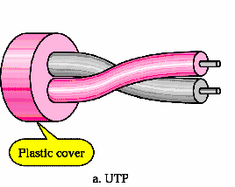
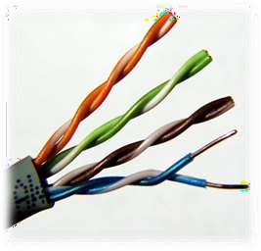
Unshielded Twisted Pair (UTP): Description
Pair of unshielded wires wound around each other
Easiest to install

Slide 24
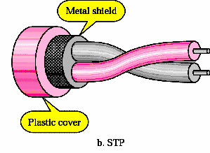
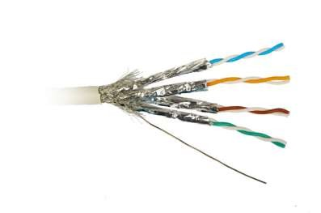
Shielded Twisted Pair (STP)
Pair of wires wound around each other placed inside a protective foil wrap
Metal braid or sheath foil that reduces interference
Harder to handle (thick, heavy)

Slide 25
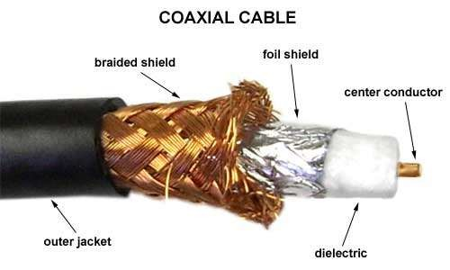
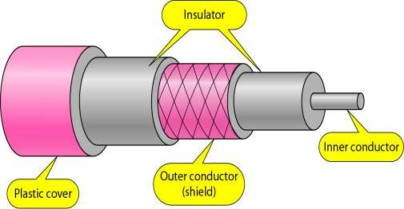
Co-axial Cable
Co-axial cable carries signal of higher frequency ranges than twisted pair cable
Inner conductor is a solid wire
Outer conductor serves as a shield against noise and a second conductor

Slide 26
Discussion divided into two basic categories for coax used in LANs:
50-ohm cable [baseband]
75-ohm cable [broadband or single channel baseband]
In general, coax has better noise immunity for higher frequencies than twisted pair.
Coaxial cable provides much higher bandwidth than twisted pair.
However, cable is ‘bulky’.
Most versatile medium
Television distribution
Long distance telephone transmission
Can carry 10,000 voice calls simultaneously
Short distance computer systems links
Local area networks

Slide 27
Fiber-Optic Cable
A fiber optic cable is made of glass or plastic and transmit signals in the form of light.
Nature of light:
Light travels in a straight line
If light goes from one substance to another then the ray of light changes direction
Ray of light changes direction when goes from more dense to a less dence substance
Optical fiber :: a thin flexible medium capable of conducting optical rays. Optical fiber consists of a very fine cylinder of glass (core) surrounded by concentric layers of glass (cladding).
a signal-encoded beam of light (a fluctuating beam) is transmitted by total internal reflection.
Total internal reflection occurs in the core because it has a higher optical density (index of refraction) than the cladding.
Attenuation in the fiber can be kept low by controlling the impurities in the glass.

Slide 28
Optical fiber
Uses reflection to guide light through a channel
Core is of glass or plastic surrounded by Cladding
Cladding is of less dense glass or plastic
An optical fiber cable has a cylindrical shape and consists of three concentric sections: the core, the cladding, and the jacket(outer part of the cable).
Jacket

Slide 29
Optical Fiber
(a) Geometry of optical fiber
light
cladding
jacket
core
(b) Reflection in optical fiber
θ_{c}

